Slide 1
Text Classification
NER
QA

Slide 2
Text Classification
Text classification is a natural language processing (NLP) task that involves assigning predefined categories or labels to text data based on its content.
The goal is to automatically categorize text into one or more classes, which can be useful for various applications such as sentiment analysis, spam detection, topic labeling, and more.

Slide 3
Applications of Text Classification:
Sentiment Analysis: Determining the sentiment expressed in a piece of text (e.g., positive, negative, neutral).
Spam Detection: Classifying emails or messages as spam or not spam.
Topic Categorization: Assigning topics to articles or documents based on their content.
Intent Recognition: Understanding user intent in chatbots or virtual assistants.
Document Organization: Automatically categorizing documents for easier retrieval and management.

Slide 4
Text classification pipeline
1. Data Collection
Gather text data from various sources (e.g., documents, social media, websites).
2. Data Preprocessing
Text Cleaning: Remove noise such as HTML tags, special characters, and punctuation.
Tokenization: Split text into individual words or tokens.
Lowercasing: Convert all text to lowercase to ensure uniformity.
Stopword Removal: Remove common words that may not contribute to the meaning (e.g., "and", "the").
Stemming/Lemmatization: Reduce words to their base or root form.

Slide 5
Text classification pipeline
3. Feature Extraction
Bag of Words (BoW): Represent text as a collection of word counts.
Term Frequency-Inverse Document Frequency (TF-IDF): Weigh words based on their frequency in a document relative to their frequency in the entire dataset.
Word Embeddings: Use techniques like Word2Vec or GloVe to represent words in a continuous vector space.
4. Model Selection
Choose a classification algorithm. Common choices include: Logistic Regression, Naive Bayes, Support Vector Machines (SVM), Decision Trees, Random Forests, Neural Networks (e.g., LSTM, BERT)
5. Model Training
Split the dataset into training and testing sets.
Train the selected model on the training data.

Slide 6
Text classification pipeline
6. Model Evaluation
Evaluate the model using metrics such as accuracy, precision, recall, F1-score, and confusion matrix on the test set.
7. Hyperparameter Tuning
Optimize model performance by adjusting hyperparameters using techniques like Grid Search or Random Search.
8. Deployment
Deploy the trained model to a production environment where it can classify new, unseen text data.
9. Monitoring and Maintenance
Continuously monitor the model's performance and update it as necessary to handle changes in data distribution or to improve accuracy.

Slide 7
QA

Slide 8





Question
Answer
QA Model
Passage / context

Slide 9
QA
A QA (Question Answering) system is a type of artificial intelligence designed to automatically answer questions posed by users in natural language.
These systems can be used in various applications, such as customer support, information retrieval, and educational tools.

Slide 10
QA
Answer Generation: Once relevant information is retrieved, the system must generate a coherent and accurate answer. This can involve summarizing information, extracting specific data, or even generating text based on the retrieved content.
Types of QA Systems:
Closed-domain QA: These systems are designed to answer questions within a specific domain (e.g., medical, legal, technical).
Open-domain QA: These systems can answer questions across a wide range of topics and often rely on large-scale knowledge bases or the internet.
Machine Learning: Many modern QA systems use machine learning techniques, including deep learning, to improve their ability to understand questions and generate answers over time.
Examples: Some well-known QA systems include virtual assistants like Siri, Alexa, and Google Assistant, as well as specialized systems like IBM Watson and various chatbots.

Slide 11
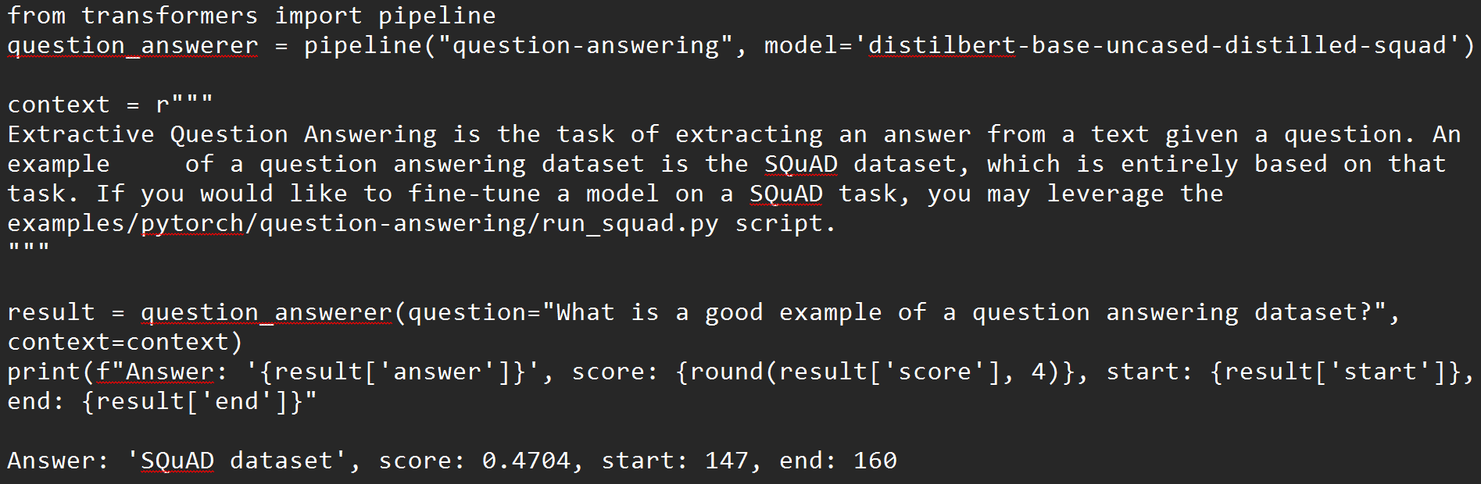

Slide 12
Named Entities Recognition
NER

Slide 13
Named Entities Recognition NER
Named Entity Recognition (NER) is a subtask of Natural Language Processing (NLP) that involves identifying and classifying named entities in text into predefined categories.
These entities can include names of people, organizations, locations, dates, quantities, and other specific items.
The primary goal of NER is to extract structured information from unstructured text, making it easier to analyze and understand.

Slide 14
Example NER
Person: Names of individuals (e.g., "Alessandro Felice").
Organization: Names of companies, institutions, or groups (e.g., "Fiat Chrysler Automobiles," "United Nations").
Location: Geographical locations (e.g., "Lecce", "Sicily").
Date: Specific dates or time expressions (e.g., "January 1, 2020").
Miscellaneous: Other entities that may not fit into the above categories, such as products or events.

Slide 15
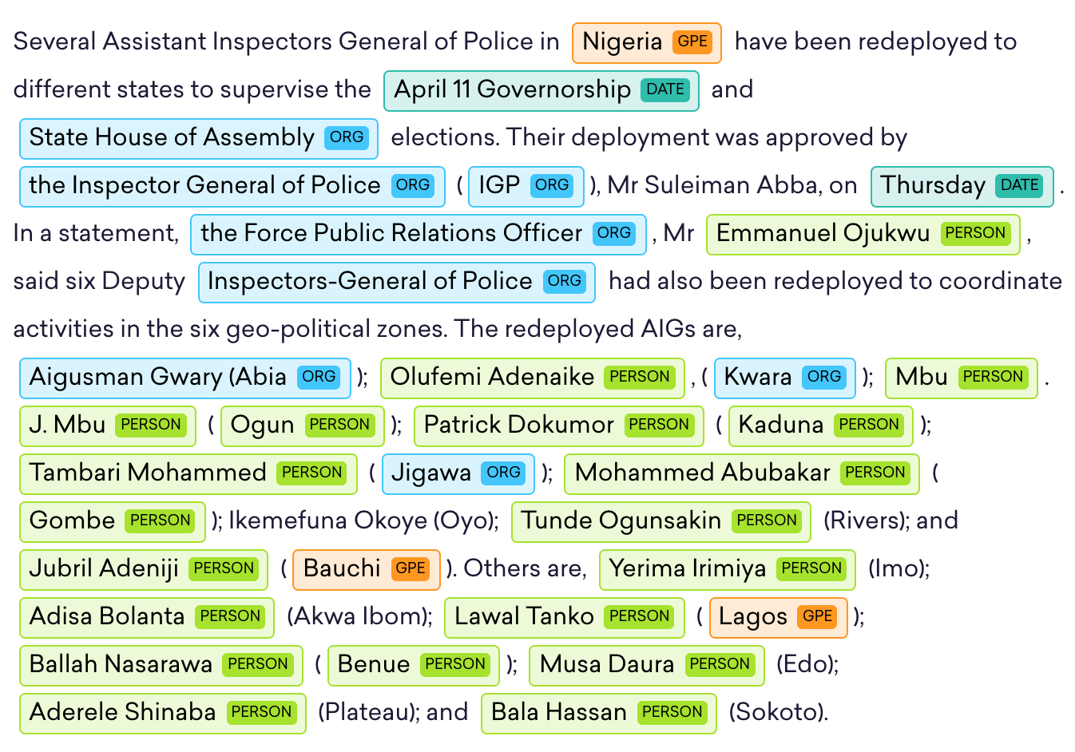
NER example

Slide 16
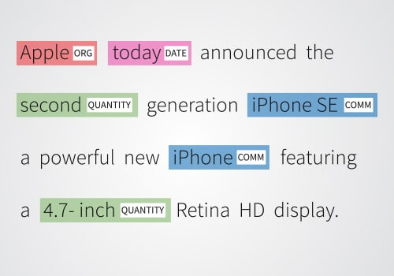
Why NER is hard!?
Comm = commercial product

Slide 17
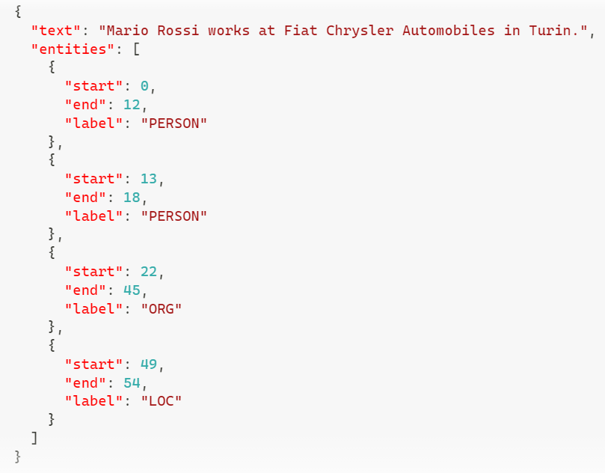
An example of dataset annotated with NEs

Slide 18
NER Applications
Information Extraction: Pulling structured data from unstructured text.
Search Enhancement: Improving search engine relevance by identifying key entities.
Content Recommendation: Suggesting articles or products based on recognized entities.
Sentiment Analysis: Understanding public sentiment towards specific entities.
Customer Support: Automating categorization of inquiries.
Social Media Monitoring: Tracking mentions and sentiment about brands or events.
Healthcare: Extracting medical entities from clinical notes.
Legal Document Analysis: Streamlining review processes by identifying legal entities.
Financial Analysis: Analyzing news for insights on companies and markets.
Chatbots: Enhancing user query understanding for better responses.

Slide 19
NER Modeling Approaches
Rule-based Systems: Using predefined rules and patterns (e.g., regular expressions) to identify entities.
Machine Learning: Training models on annotated datasets to recognize entities based on features extracted from the text.
Deep Learning: Utilizing neural networks, particularly architectures like LSTM, CRF (Conditional Random Fields), or Transformers (e.g., BERT), to achieve high accuracy in entity recognition.

Slide 20
NER Modeling Approaches
Approach | Advantages | Disadvantages
Rule-based Systems | Simple and transparent No training data required | Limited flexibility and generalization Maintenance required for evolving language Performance may suffer on complex sentences
Machine Learning | Better generalization with training data Adaptable to specific domains | Requires feature engineering Performance relies on quality of training data More complex to implement
Deep Learning | State-of-the-art performance- Captures contextual information End-to-end learning | Requires large amounts of labeled data Computationally intensive Less interpretable (black box)

